Slide 1






VITISH 2025 (SIH Internal Hackathon)
PS ID: SIH25047
PS Title: Disaster Response Drone for Remote Areas
Theme: Robotics and Drones
PS Category: Hardware
Team ID: VIT-865

Slide 2
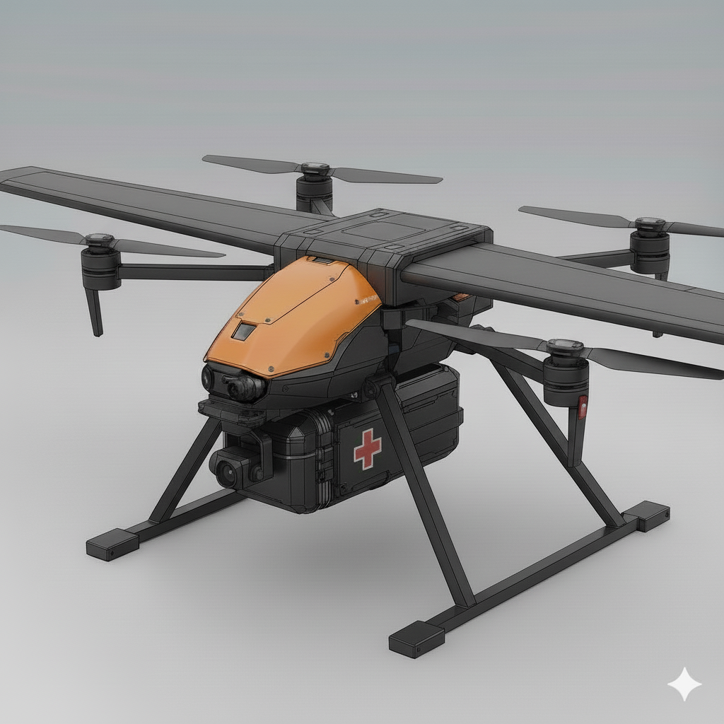
PROJECT NIMBUS
Proposed Solution
Hybrid VTOL medical drone
Solves problem by
Works in remote areas with little or no access to Wi-Fi by using LTE IP
Can take-off in tight spaces and fly long range distances
Innovation & Uniqueness
Modular Payload Bay
Self-built avionics (Pixhawk-class)
Vertical take-off + plane-like speed
AI navigation & obstacle avoidance
Nimbus 007 (Concept)

Slide 3
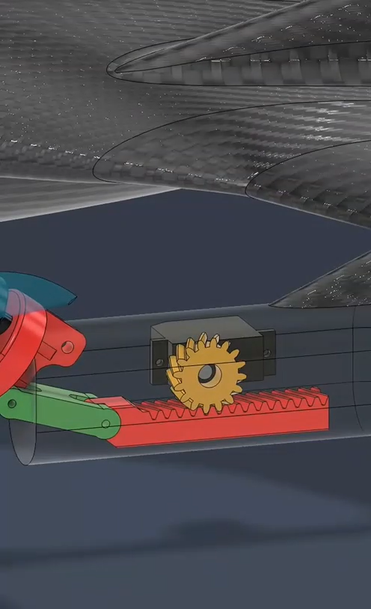
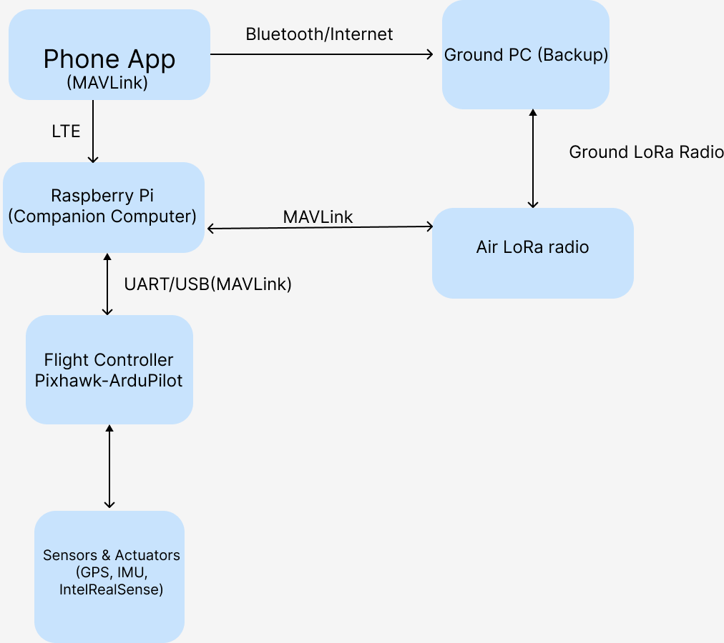
TECHNICAL APPROACH
Hardware:
https://docs.google.com/spreadsheets/d/1F6OGOesjAs7q4XyuNf6iJS6DM2Ykt9MaWld0UDiYUrY/edit?usp=sharing
Flight Computer: STM32H743VIH6
Companion Computer: RasperryPi
Tilting rotor mechanism
Sensors: GPS, LIDAR/Ultrasonic, IntelRealSense Camera
Medical payload module (compact container)
Software / AI:
Programming: Python, C++, React Native for App
Flight control: Pixhawk 6c
Simulation: Gazebo, MATLAB/Simulink
AI navigation: OpenCV, Distance estimation is done by combining YOLOv8 with depth data from IntelRealSense to get accurate 3D positions of detected objects

Slide 4
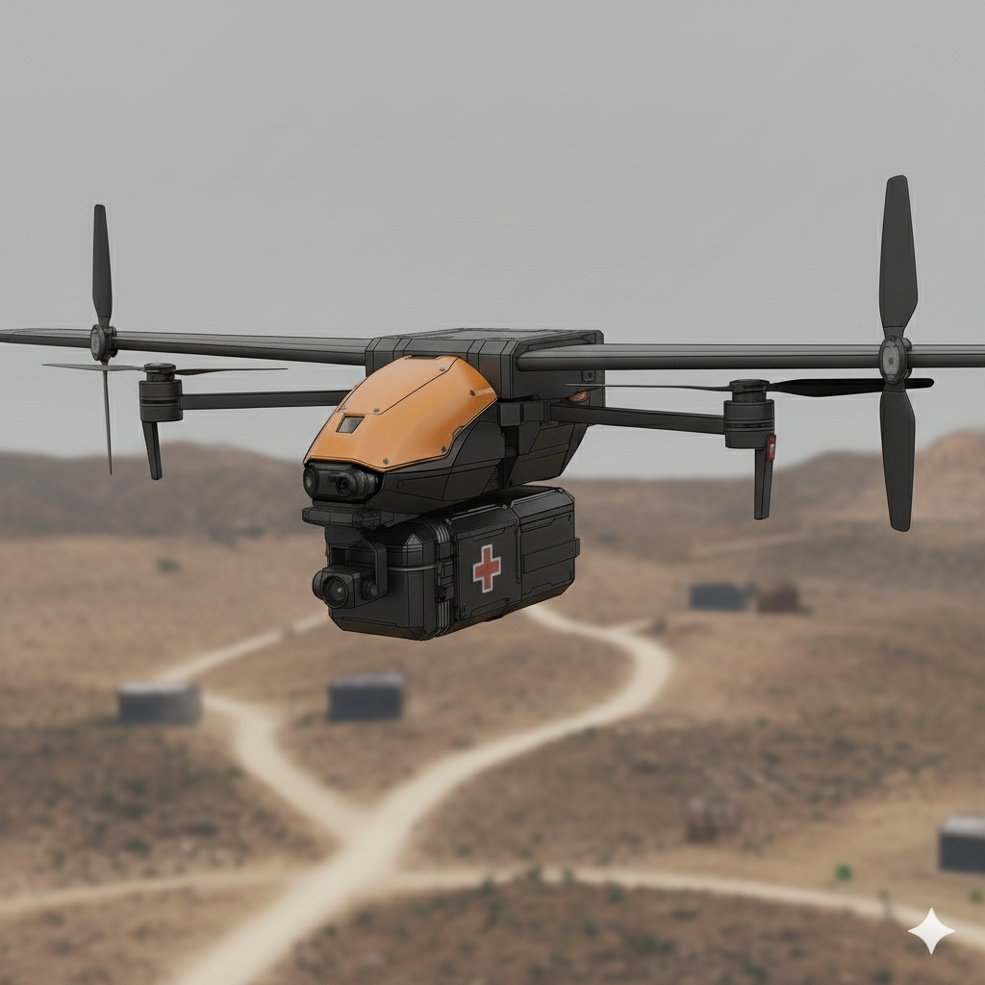
FEASIBILITY AND VIABILITY
Feasibility Analysis:
Technical: 7(+0.5)Kg possible with 4 motors
Economic: Prototype Cost ~₹1.5 lakh, scalable and cost-efficient in bulk
Operational: Quick deployment from relief trucks/camps
Regulatory: Govt. support ensures compliance
Potential Challenges
Mitigation Strategy
Weather Constraints → Strong winds/rain may affect operations.
Payload Constraints → Weight and secure handling of medical kits.
Navigation Risks → GPS jamming, obstacle-dense areas.
Battery Limitations → Limited flight range.
Swappable high-capacity batteries / solar charging stations
Weather-resilient design + fallback emergency landing protocols
Hybrid navigation (GPS + AI vision + IMU fusion).
Lightweight modular payload containers with shock absorption

Slide 5
Benefits
Social:
Cuts response time, saving lives and strengthening community resilience
Economic:
Reduces disaster relief costs with scalable, efficient deployment.
Environmental:
Electric, eco-friendly operations protect fragile ecosystems.
Technological:
Boosts indigenous innovation with custom avionics and autonomy.
Potential Impact on Target Audience
Disaster Victims → Faster access to critical medicines, communication devices, and first-aid
Relief Agencies & Hospitals → Reduced delays in supply chain during emergencies
Remote Communities → Connectivity and medical access where traditional transport fails

Slide 6
RESEARCH AND REFERENCES
Key References Used
Disaster Relief Drones – Case Studies
UNICEF & WHO reports on UAVs for medical supply delivery.
Hybrid VTOL Drone Research
IEEE Xplore papers on VTOL efficiency & hybrid propulsion.
Navigation & AI in Drones
MIT research on AI-based obstacle avoidance.
Power & Control Systems
Electronics tutorials (Arduino, sensors, motor drivers) + LTSpice simulations.
Links / Resources
WHO – Drones for Health Delivery
https://www.zipline.com/
IEEE Xplore – UAV & VTOL Papers
NASA – UAV Navigation Research
KiCAD Circuits & LTSpice Simulations

